Slide 1


Set #1
Daily CSI
CSI Challenge
Mystery Pictures
8th Grade Forensic Science
T. Trimpe 2006 http://sciencespot.net/

Slide 2
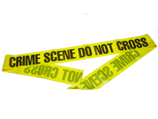
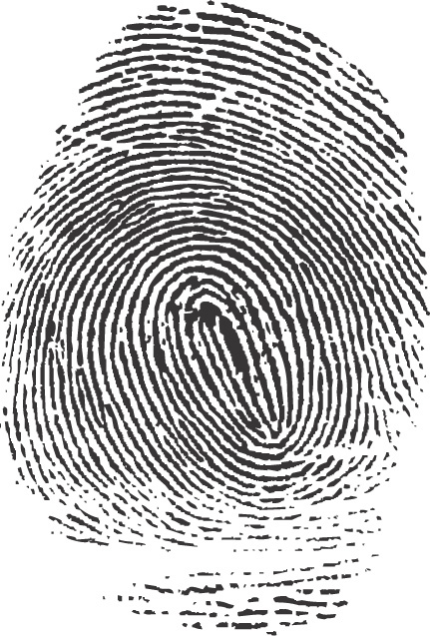
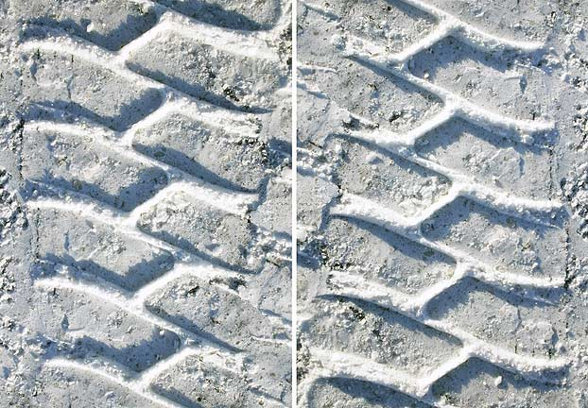
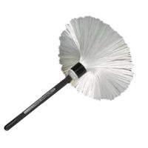
Can you identify the mystery items?
All the items are associated with crime scene investigations.
#3
#1
#4
#2

Slide 3
The answers are …
#3
#1
#4
#2

